Slide 1
هوش محاسباتی:
شبکه های عصبی مصنوعی
دانشكده مهندسي كامپيوتر
دانشگاه علم و صنعت ايران
ناصر مزيني mozayani@iust.ac.ir
مدل Kohonen

Slide 2
Self Organizing Networks

Slide 3
Introduction
A supervised network tries to obtain a mapping between input and output
A SO algorithm tries to discover important and meaningful features from input data
Such an algorithm has a set of local rules (changes in weights are made in a neighborhood of neurons)
Question :
How a useful configuration can finally develop from self organization ?
Answer can be lied in Turing observations (1952) :
  Global order can arise from local interactions
Biological justifications exist

Slide 4
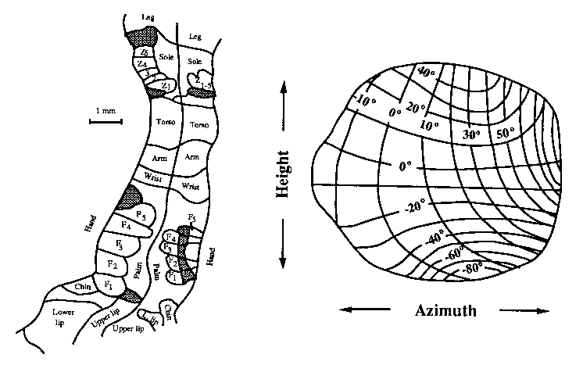
Biological system
Map of part of the body surface in the somatosensory cortex of a monkey
Direction map for sound signals in the so-called “optical tectum” of an owl

Slide 5
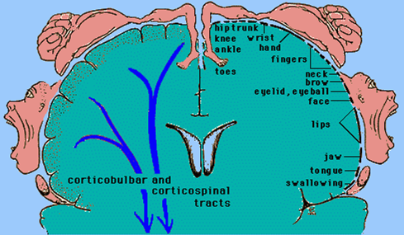
Biological system (cont’d)
Map of the body surface in the human motor cortex : (Homunculus precentral Gyrus)

Slide 6
Biological system (cont’d)
Is it probable that in biological systems such map is genetically determined?
The brain is estimated to have ~10¹⁴ synapses (connections), so it would be impossible to produce this organization by specifying each connection in detail
the genome does not contain that much information
(i) wiring diagram would require ≥ 10¹⁴ bits of information
(ii) genome carries about 5x10⁹ bits of information
(iii) human genome is about one meter of DNA
(iv) 4 types of base pairs
(v) separation of 4x10⁻⁸ cm between base pairs
(vi) much of genome is junk

Slide 7
Biological system (cont’d)
A more likely scenario is that there are genetically specified mechanisms of structure formation that result in the creation of the desired connectivity
These could operate before birth, or as part of later maturation, involving interaction with the environment
There is much evidence for such changes:
  the normal development of edge-detectors in the visual cortex of newborn kittens is suppressed in the absence of sufficient visual experience
  the somatosensory maps of adult monkeys have been observed to adapt following the amputation of a finger

Slide 8
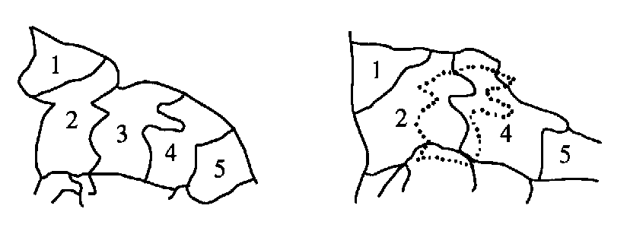
Biological system (cont’d)
Readaptation of the somatosensory map of the hand region of an adult nocturnal ape due to the amputation of one finger. Several weeks after the amputation of the middle finger (3), the assigned region has disappeared and the adjacent regions have spread out. [Ritter et al., p. 117]

Slide 9
Principles of SO
Some intuitive principles of SO:
Modifications in synaptic weights tend to self amplify
Limitation of resources leads to competition among synapses
Competition leads to the selection of the most vigorously growing synapses at the expense of the others
Modifications in synaptic weights tend to cooperate

Slide 10
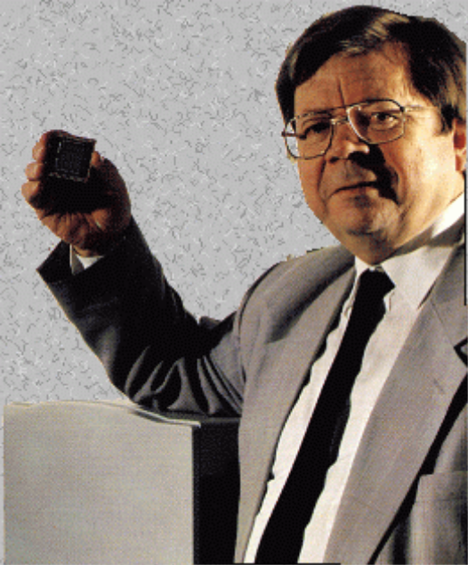
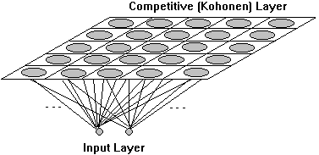
Two Basic models of SO
1- Willshaw von del Malsburg
2- Kohonen model (SOFM):
A continuous input space of activation patterns is mapped to a discrete output
space of neurons by a process of competition among the neurons in the network

Slide 11
Formation of SOM
Essential processes of a SOFM are:
Initialization
Competition
Cooperation
Synaptic Adaptation
1- Initialization of the synaptic weights is done by assigning random small values in order to impose no prior order on the map

Slide 12
2- Competition
An input vector x selected at random and presented to the network
        Input vector: X=[x₁, x₂,…, x_{m}]^{T}
        Weights vector: W_{j}=[w_{j1}, w_{j2},…, w_{jm}]^{T}
A neuron is selected as the winner based on a best matching criterion
The Euclidian distance: i(x)=arg min ||X-W_{j}||

Slide 13
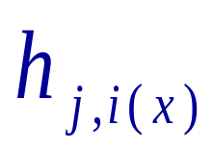
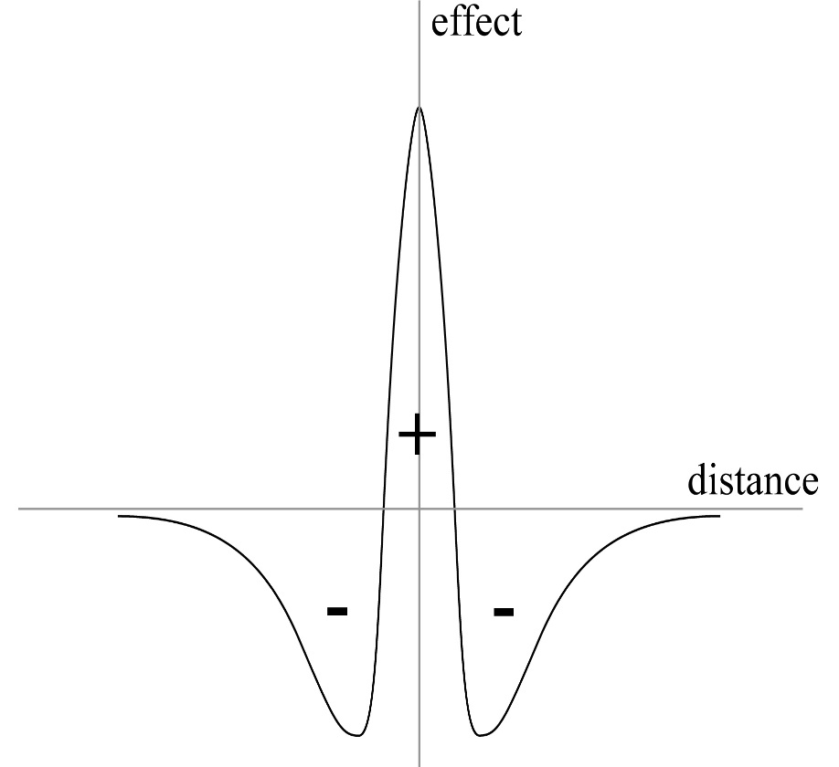
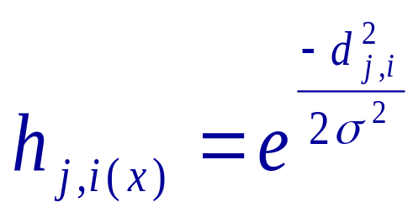
3- Cooperation
A topological neighborhood of the winning neuron is selected
The best form is a Mexican hat function:
A simpler typical choice can be a
Gaussian function:

Slide 14
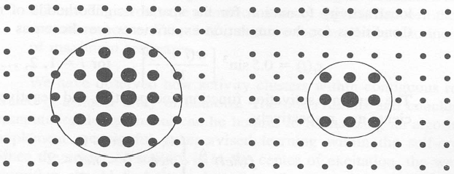
Neighborhood function
Selected neurons in
a large neighborhood
Selected neurons in
a small neighborhood

Slide 15
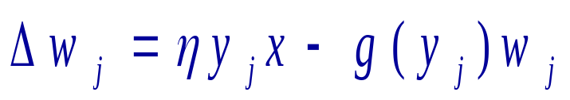
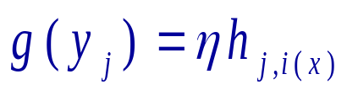
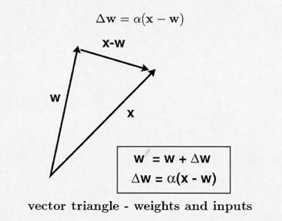
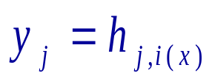
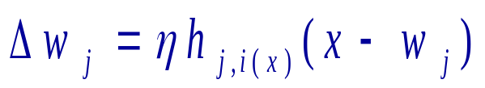
4- Adaptation
Synaptic weights are modified according to :
Forgetting term
Hebb Rule
By choosing :
and:
We obtain :

Slide 16
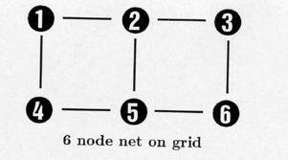
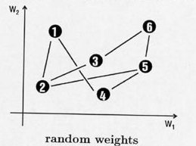
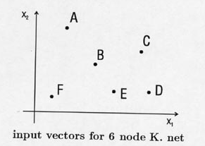
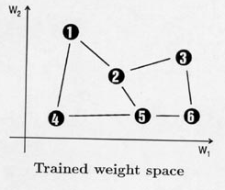
Example 1

Slide 17
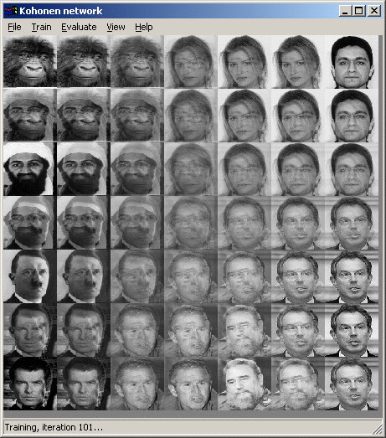
Example 2

Slide 18
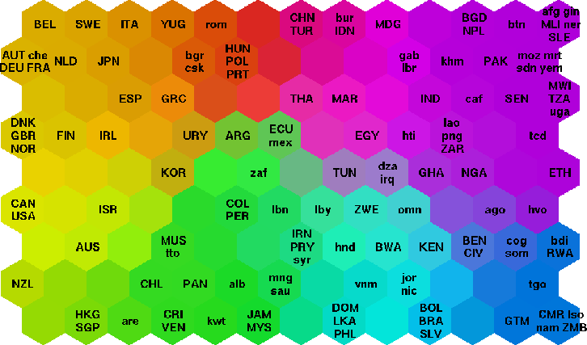
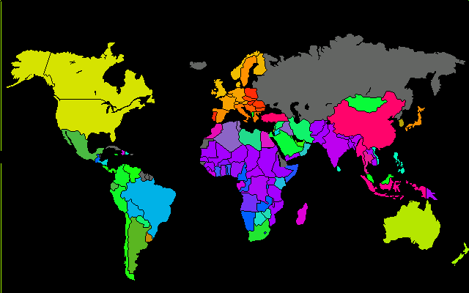
Example 3: Poverty Map
http://www.cis.hut.fi/research/som-research/worldmap.html

Slide 19
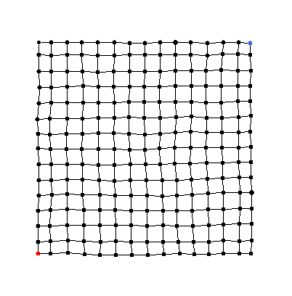
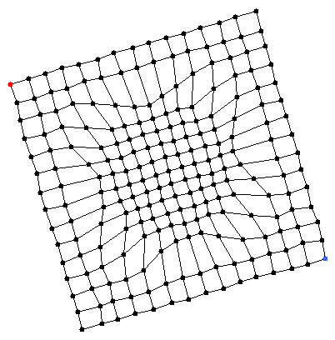
Example 4
SOM that has learnt data uniformly distributed on a square
SOM that has learnt data on a rotated square, where points are twice as likely to occur in a circle at the centre of the square (relationship to clustering)

Slide 20
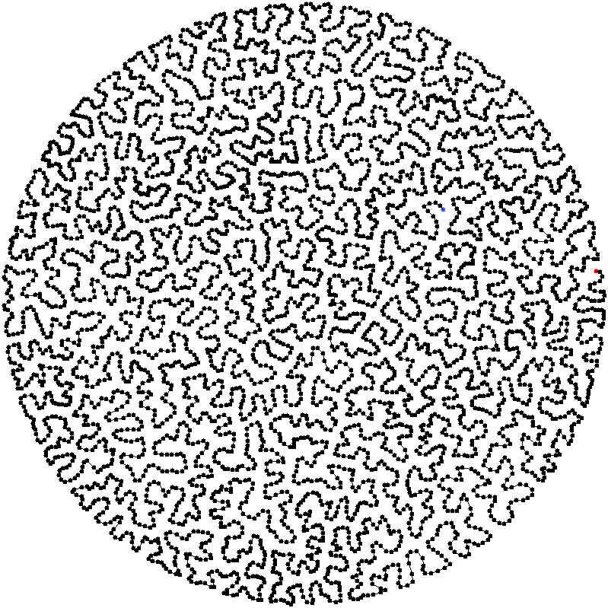
Example 5
1-dimensional SOM that has learnt data uniformly distributed in a 2-dimensional circle

Slide 21
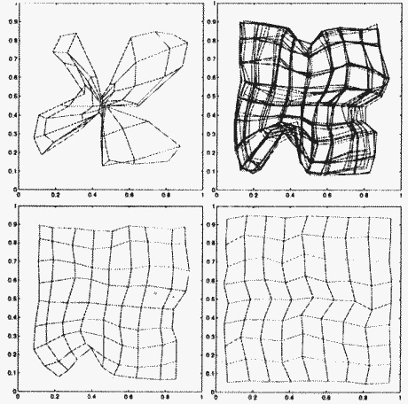
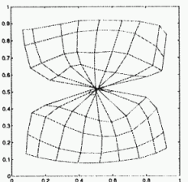
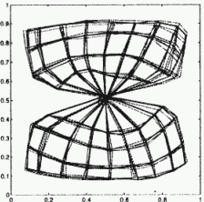
Example 6
Map distortions
Initial distortions may slowly disappear or may get frozen

Slide 22
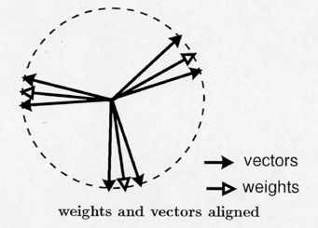
Vector representation
A learnt SOFM has a set of weights vector fitted in clusters of input vectors:

Slide 23
Properties of SOFM
Approximation of the input space
Feature selection of nonlinear distributed data
A topographic representation of multi-dimensional input space
Topological ordering
Density matching (respecting the input distribution)

